Slide 1

SCPERB:SINGLE-CELL PERTURBATION
VIA STYLE TRANSFER-BASED VAE
2023 丘成桐中学科学奖计算机组答辩
演讲者：汤子嘉 时间：2023.12
指导老师：Qianqian Song, 胡正勇

Slide 2
PART 01
Background
研究背景

Slide 3
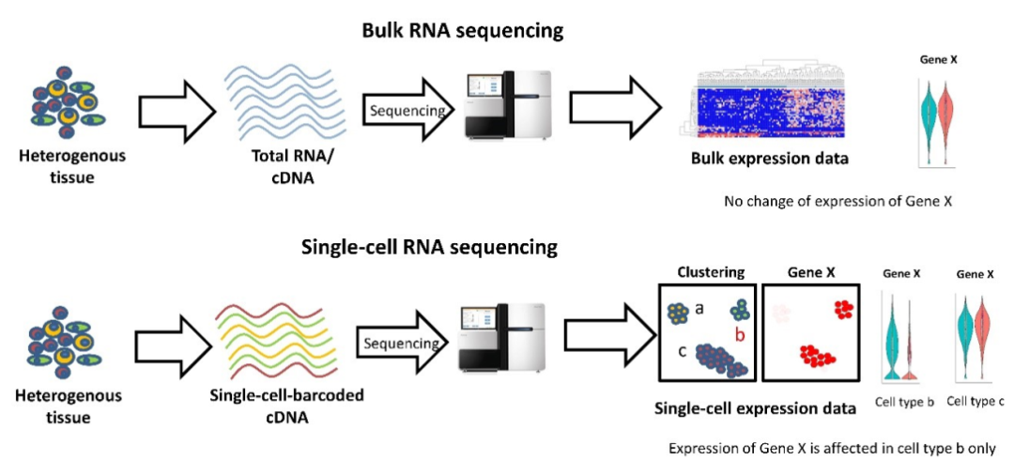
01
Background
Single-cell RNA sequencing technique
Bulk RNA sequencing technique (traditional)
Single-cell RNA sequencing technique
Source: 恒诺新知,(2021). 单细胞RNA-seq介绍

Slide 4

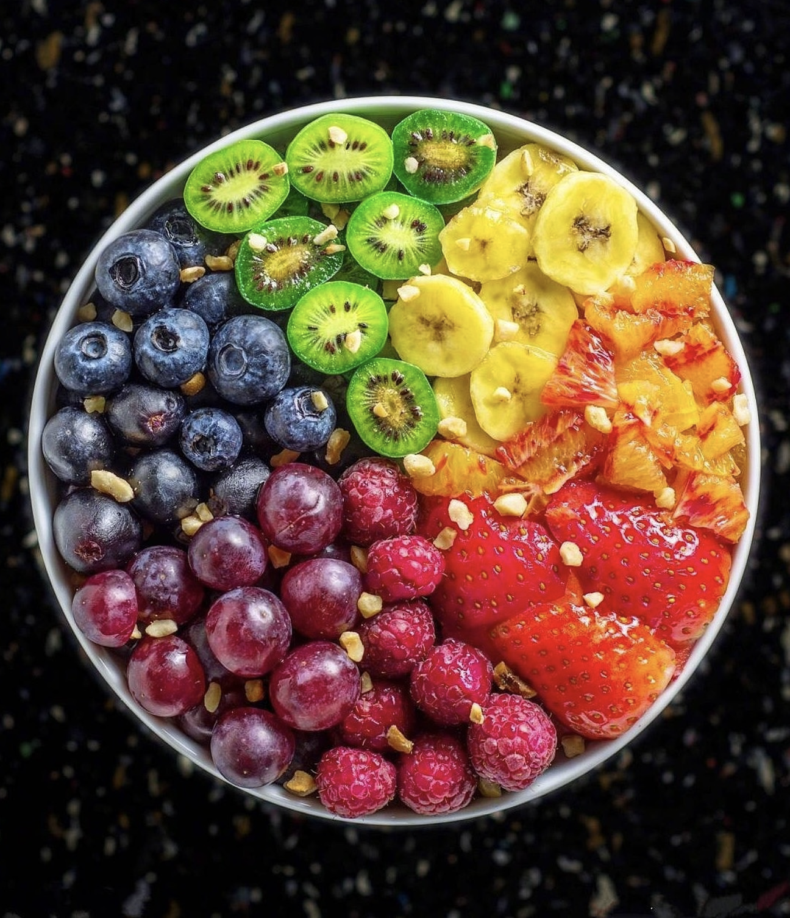
01
Background
Single-cell RNA sequencing technique
Bulk RNA sequencing technique (traditional)
Single-cell RNA sequencing technique

Slide 5
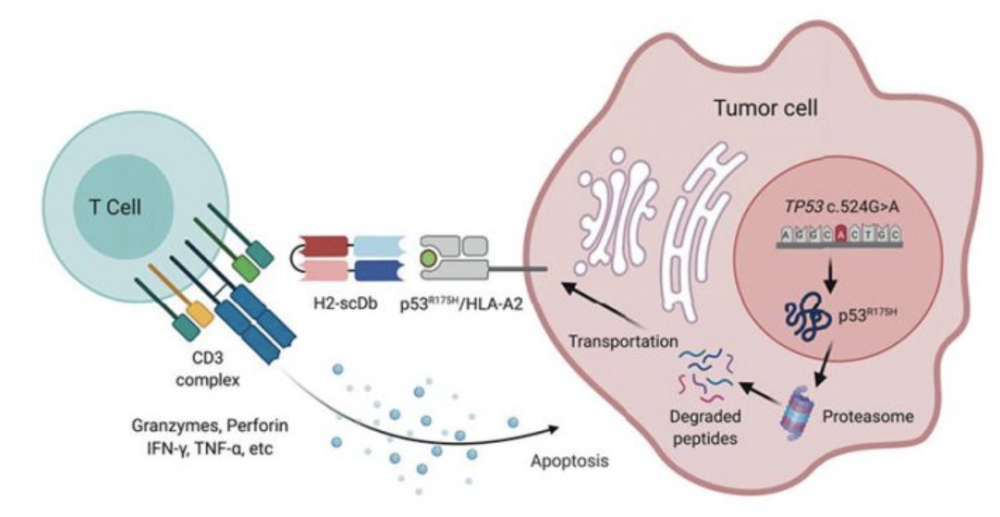
01
Background
Definition of perturbation：
The change of the gene expression of cells after stimulus.
Cytokines, Stimulus
Source: Hsiue et al.^{[1]}

Slide 6
01
Background
Perturbation prediction could provide insight for curing diseases.
e.g. Testing whether a kind of new drug could suppress tumor cells or not.
Unknown drug efficacy before clinal trials
Researchers leverage deep learning techniques to predict the effectiveness of drugs
Could this drug significantly decrease tumor-related gene expression？
Whether it could increase the gene expression of tumor-suppressive genes？
Our goal is to provide accurate predictions of gene expressions in perturbed cells, thus to identify effective stimulus/drug molecules for novel drug discovery and curing disease.

Slide 7
PART 02
Benchmarking
方法对比

Slide 8
02
Benchmarking
Benchmarking
Statistic methods: such as linear regression.
GANs: such as sc-WGAN^{[3]}, and style transfer GAN^{[4]}
VAEs: such as CVAE and scGen^{[2]}.
Limitations
Statistic methods have poor predicting ability for non-linear cases.
GANs would provide “versatile” results, and the training process is not stable.
VAEs could result in “vague” results (i.e. could not divide control data from perturbed data).

Slide 9
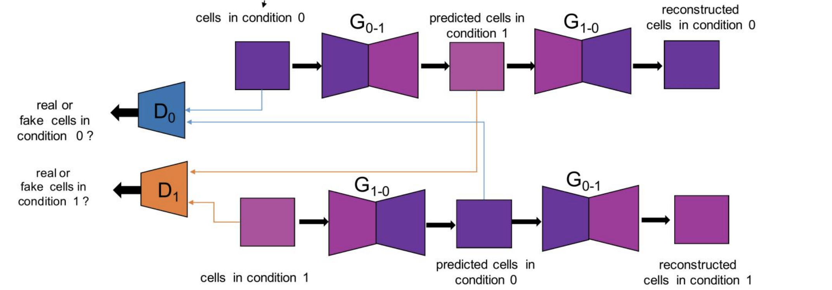
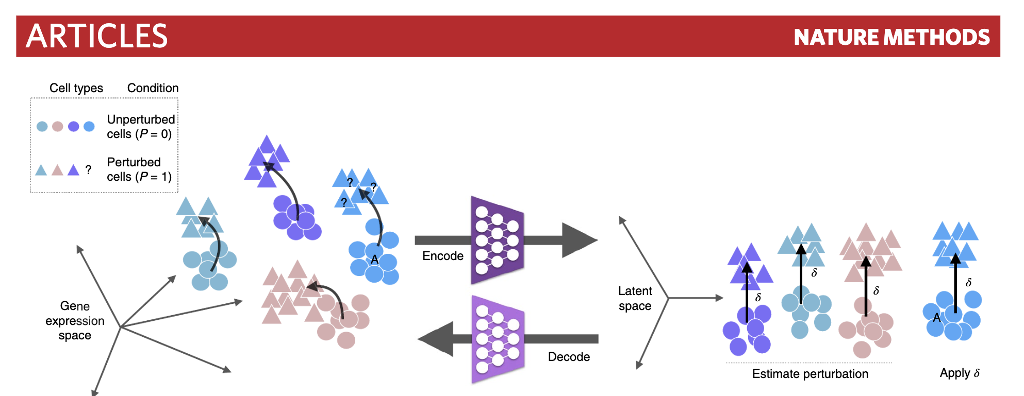
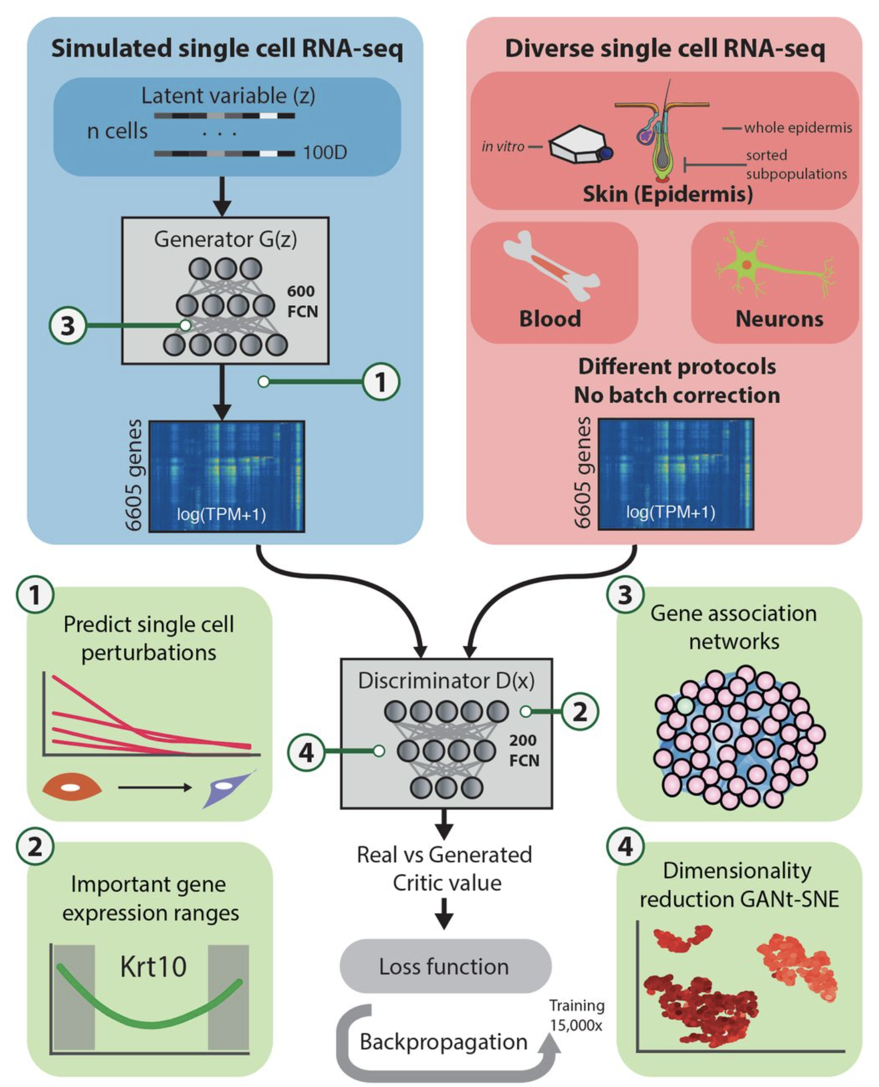
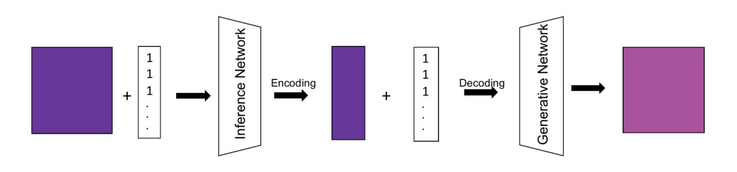
02
stGAN
Benchmarking
scGen
sc-WGAN
CVAE
Source: Lotfollahi et al^{[2]}

Slide 10
02
Benchmarking
scGen
Source: Lotfollahi et al^{[2]}

Slide 11
02
Benchmarking
sc-WGAN
Source: Ghahramani et al^{[3]}

Slide 12
02
Benchmarking
CVAE
stGAN
Source:Karras, T et al^{[4]}

Slide 13
PART 03
Overview
研究内容

Slide 14
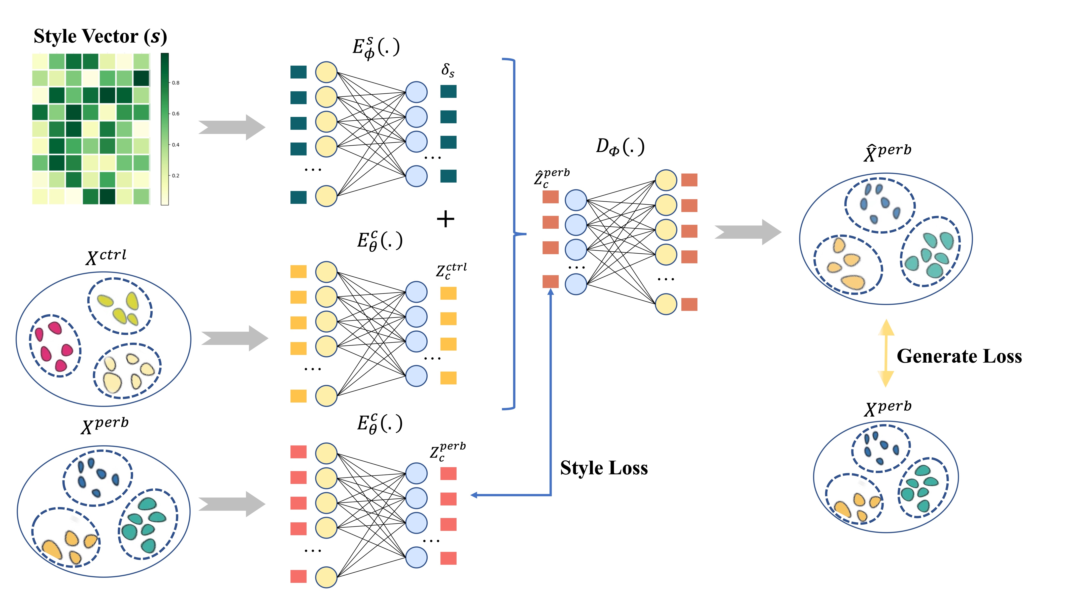

03
Overview

Slide 15
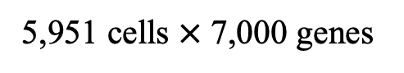
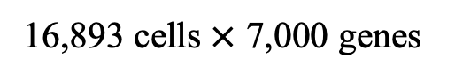
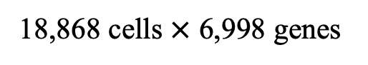
03
Overview
18,868 cells $×$ 6,998 genes
Datasets
5,951 cells $×$ 7,000 genes
16,893 cells $×$ 7,000 genes

Slide 16
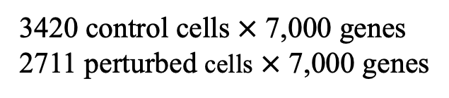
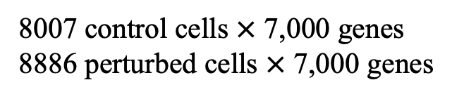
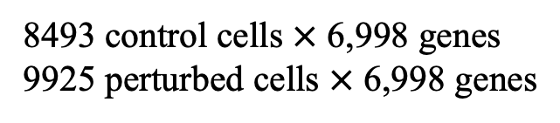
8493 control cells $×$ 6,998 genes
9925 perturbed cells $×$ 6,998 genes
03
Overview
Datasets
3420 control cells $×$ 7,000 genes
2711 perturbed cells $×$ 7,000 genes
8007 control cells $×$ 7,000 genes
8886 perturbed cells $×$ 7,000 genes

Slide 17
PART 04
results
实验结果

Slide 18
04
Results
Comparison
Ours Model

Slide 19
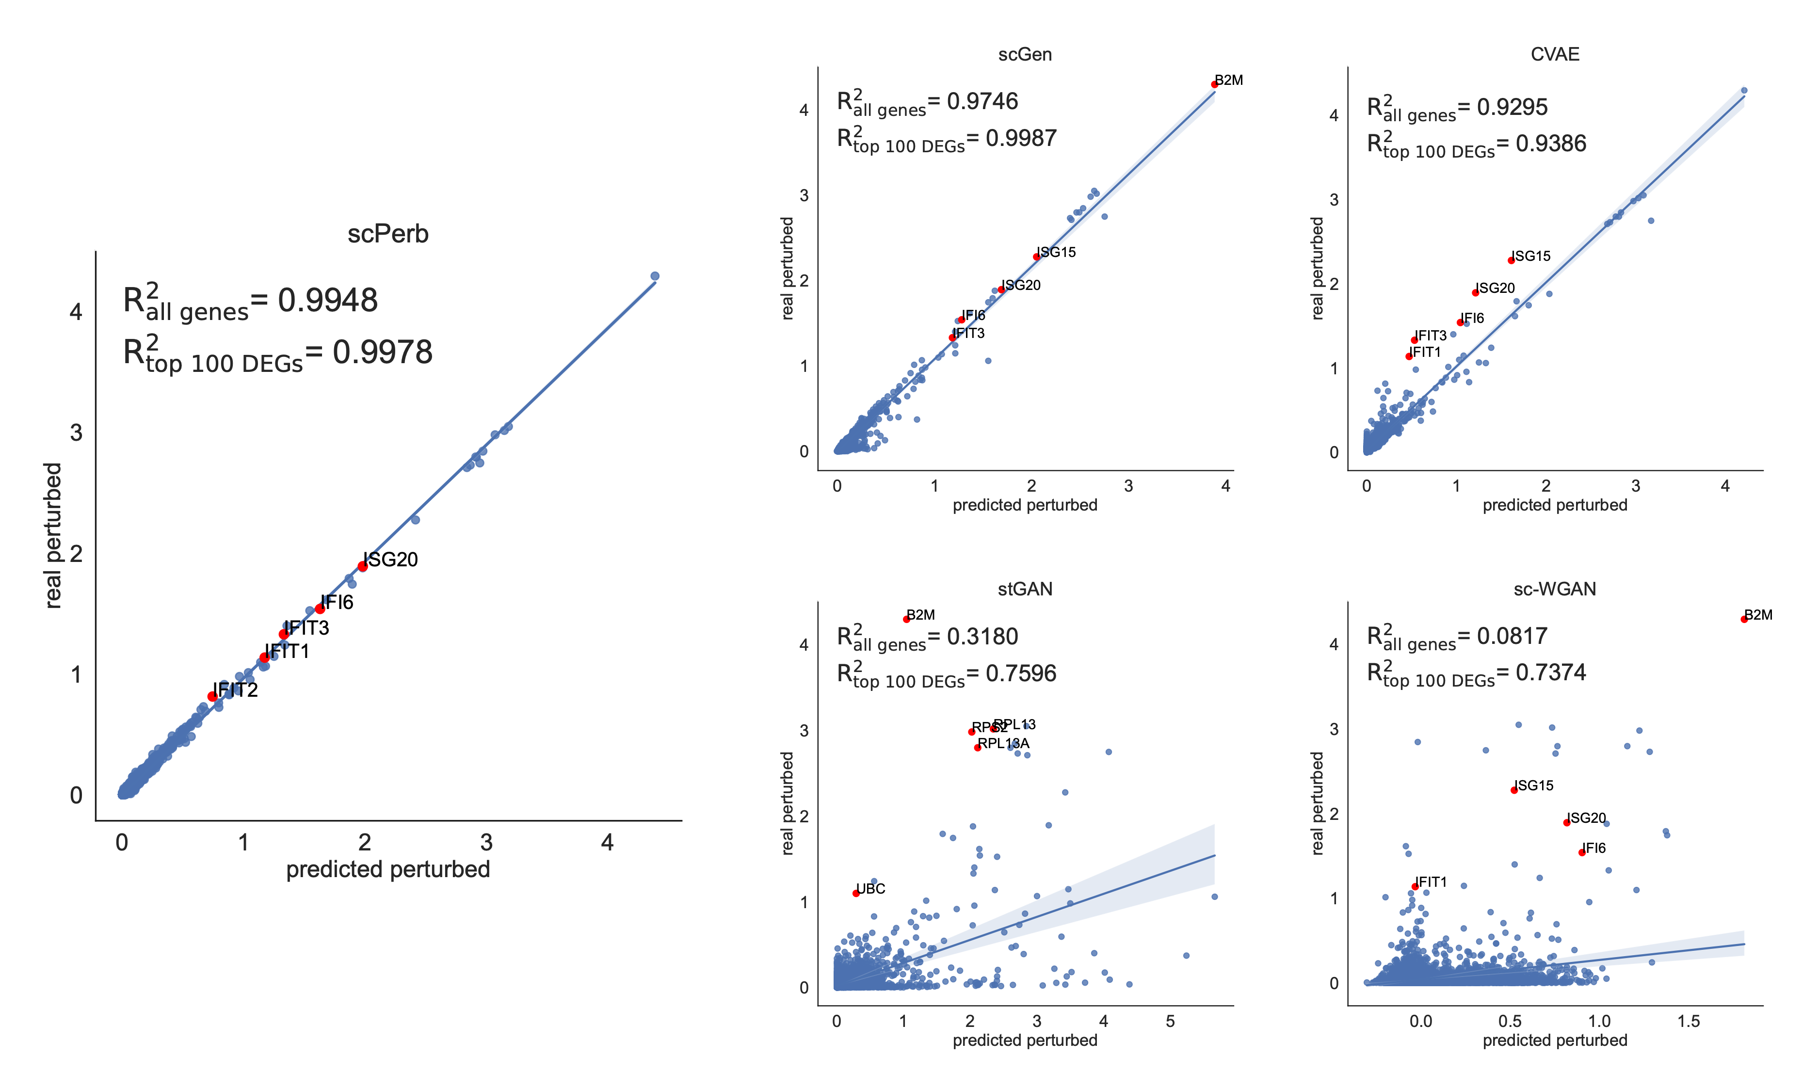
04
Results
scGen
CVAE
PBMC-Kang dataset
scPerb(ours)
stGAN
sc-WGAN

Slide 20
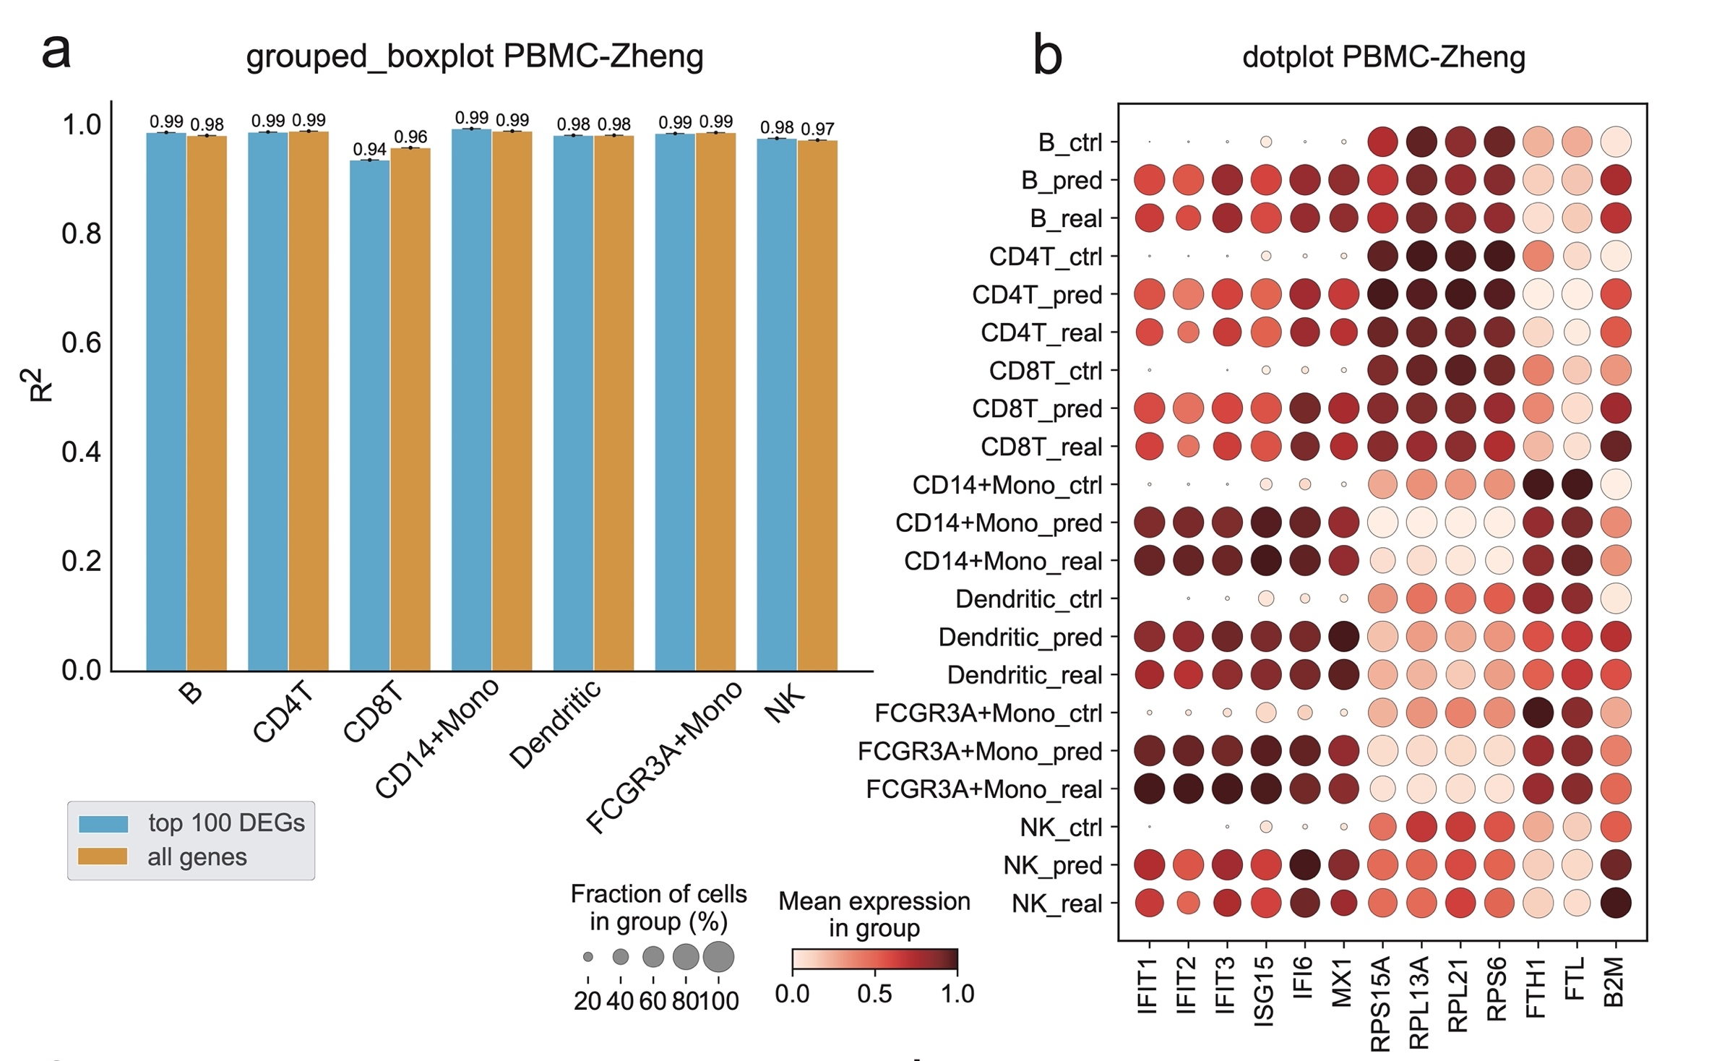
04
Results
PBMC-Zheng dataset

Slide 21
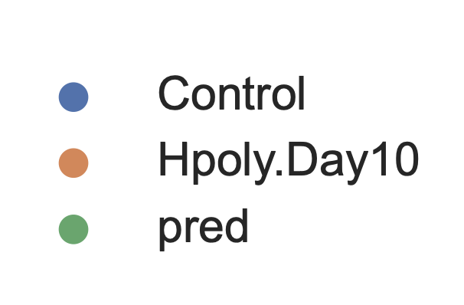
04
Results:
CVAE
stGAN
H.poly dataset
scPerb(ours)
scGen
sc-WGAN

Slide 22
PART 05
Future Work
未来展望

Slide 23
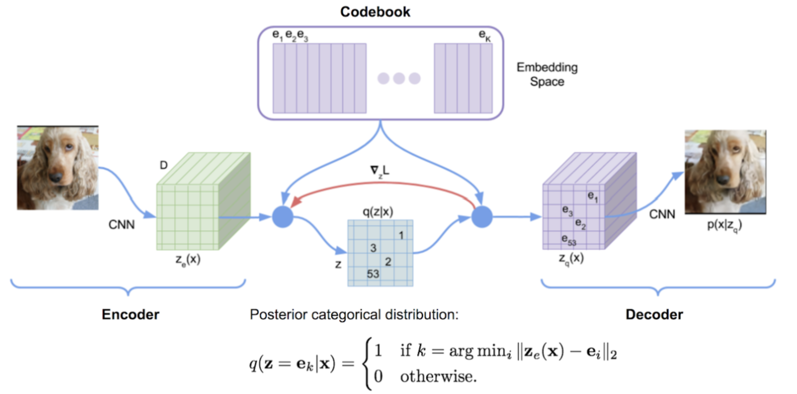
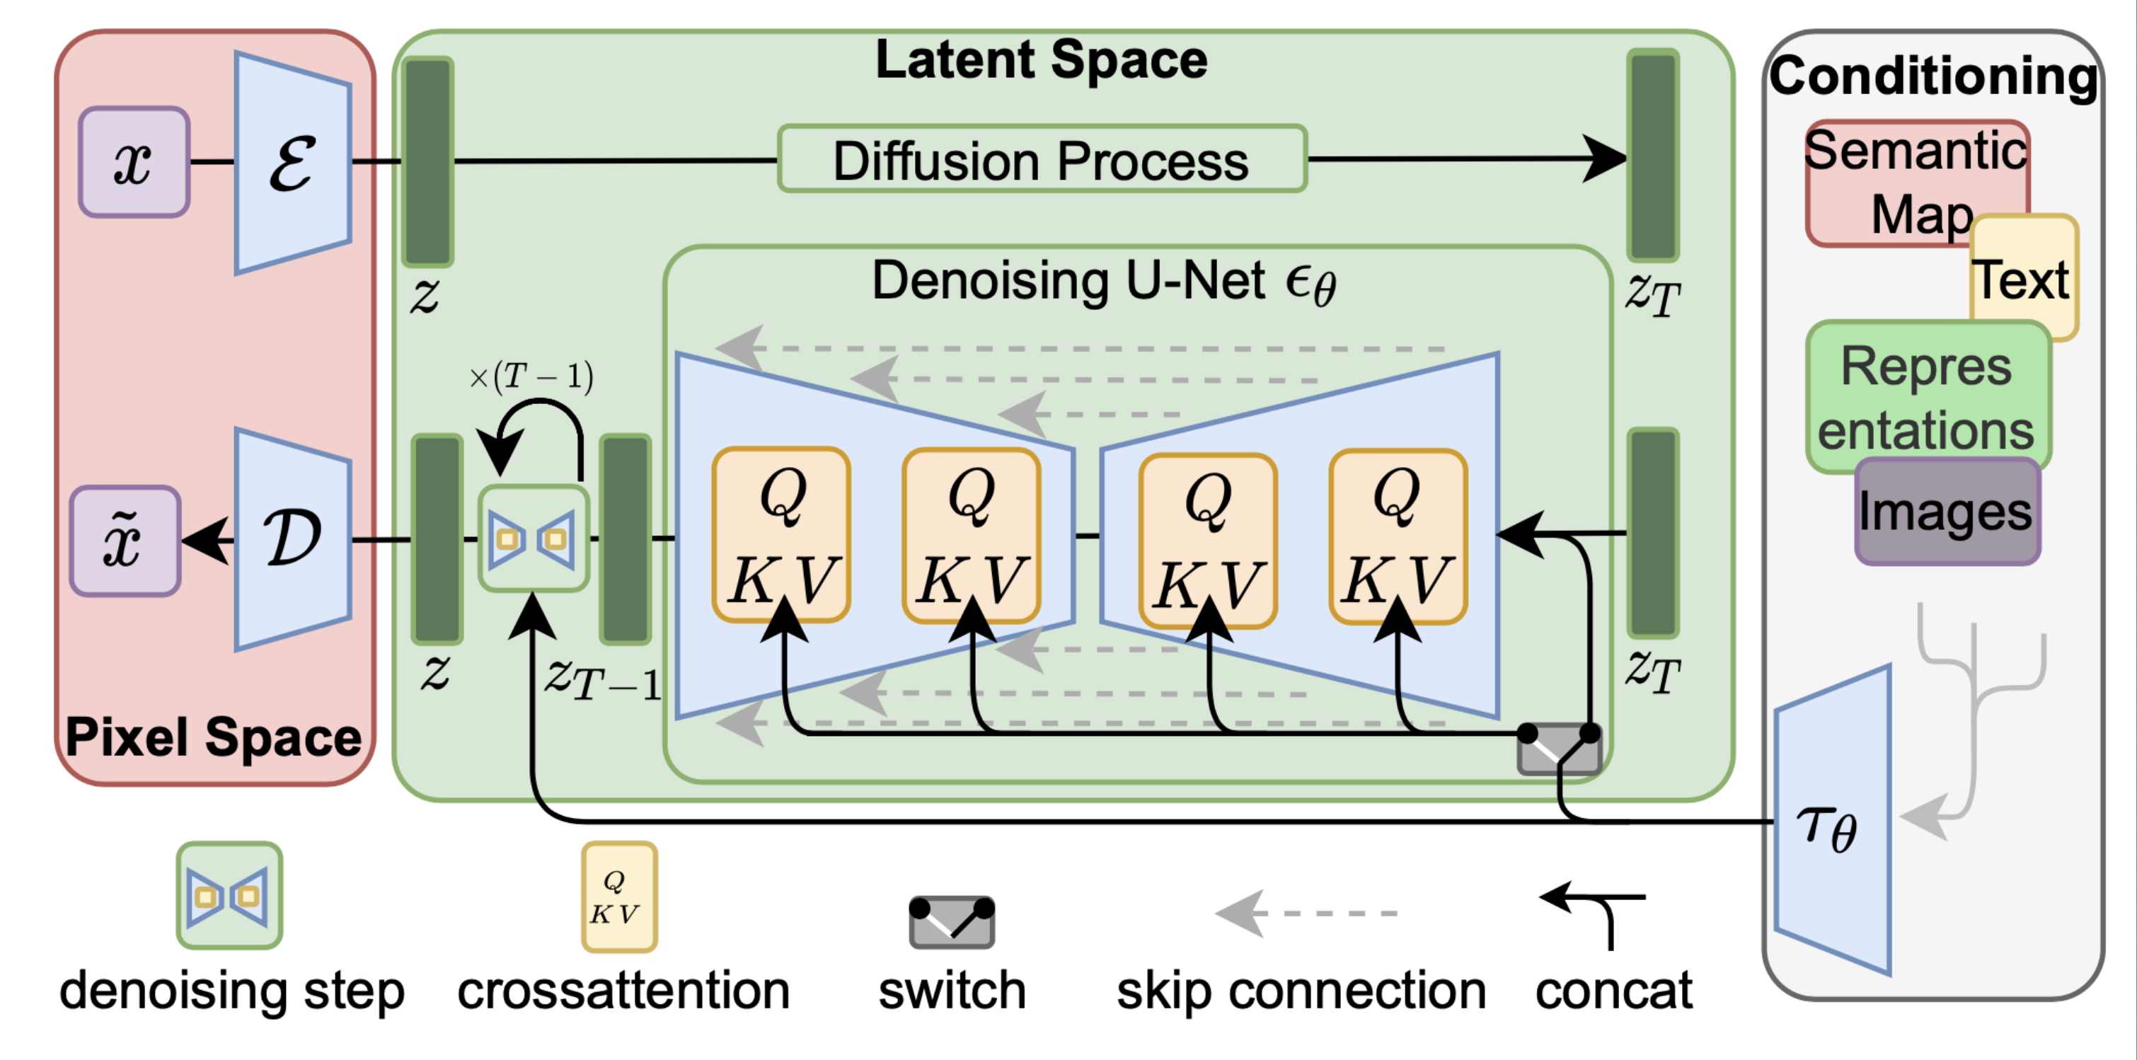
05
Future Work
Next step of our model:
VQVAE
Diffusion model
Source:Rink, N.A., et al.^{[8]}
Source:Rombach, R., et al.^{[9]}

Slide 24
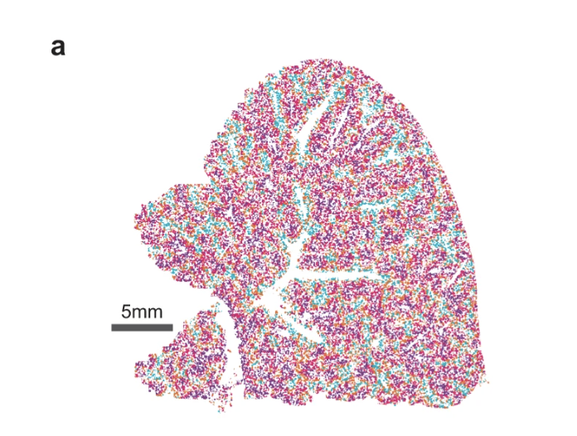
05
Future Work
Next generation of single-cell perturbation:
single-cell spatial perturbation.
Spatial Transcriptomics
The Spatial Transcriptomics technique capture more detailed gene expression at the sub-cellular level, providing information on the location of cells.
Spatial Perturbation Prediction could further predict:
The reaction of cells after perturbation.
This method may trigger breakthroughs in fields such as tissue cell function, microenvironment interaction, developmental process lineage tracking, and disease pathology.
Source: Tang, Z et al.^{[10]}

Slide 25
06
References
Perturbation：Hsiue E H C, Wright K M, Douglass J, et al. Targeting a neoantigen derived from a common TP53 mutation[J]. Science, 2021, 371(6533).
scGen: Lotfollahi, M., F.A. Wolf, and F.J. Theis, scGen predicts single-cell perturbation responses. Nature Methods, 2019. 16(8): p. 715-721.
sc-WGAN: Ghahramani, A., F.M. Watt, and N.M. Luscombe, Generative adversarial networks uncover epidermal regulators and predict single cell perturbations. bioRxiv, 2018: p. 262501.
stGAN: Karras, T., S. Laine, and T. Aila. A style-based generator architecture for generative adversarial networks. in Proceedings of the IEEE/CVF conference on computer vision and pattern recognition. 2019.
Pbmc-Zheng dataset: Zheng, G.X., et al., Massively parallel digital transcriptional profiling of single cells. Nature communica- tions, 2017. 8(1): p. 14049.
Pbmc-Kang dataset: Kang, H.M., et al., Multiplexed droplet single-cell RNA-sequencing using natural genetic variation. Nature biotechnology, 2018. 36(1): p. 89-94.
Hpoly dataset: Haber, A.L., et al., A single-cell survey of the small intestinal epithelium. Nature, 2017. 551(7680): p. 333-339.
VQVAE: Rink, N.A., et al., Memory-efficient array redistribution through portable collective communication. arXiv preprint arXiv:2112.01075, 2021
Diffusion model: Rombach, R., et al. High-resolution image synthesis with latent diffusion models. in Proceedings of the IEEE/CVF conference on computer vision and pattern recognition. 2022.
Spatial: Tang, Z., Li, Z., Hou, T. et al. SiGra: single-cell spatial elucidation through an image-augmented graph transformer. Nat Commun 14, 5618 (2023).

Slide 26
2023
Thanks for listening!
2023 丘成桐中学科学奖计算机组答辩
演讲者：汤子嘉 时间：2023.12

Slide 27
Q&A

